Slide 1
Biofuels Impact on the Corn Supply
Unit 5, Lesson 2

Slide 2

Value-add markets, Rural stimulus
  Farm expenditures and employment opportunities have increased and are projected to continue due to additional ethanol production and use.
  Farmers can realize added benefits of the ethanol industry through ownership of manufacturing plants.
  Ethanol production creates domestic markets for corn and adds four to six cents a bushel for each 100 million bushels used.
  Better corn prices mean less reliance on government subsidy programs and more income and independence for farmers.
  Ethanol production will help increase net farm income more than $6.6 billion over the next 15 years.

Slide 3
Value-add markets, Rural stimulus
  Ethanol production consumed 5.1 billion bushels bushels of corn in 2014.
  Ethanol production uses about 36 percent of the nation’s corn crop.
  The partial tax exemption for ethanol blend fuels creates jobs (290,000), stimulates economic activity ($44 billion GDP), and reduces the U.S. trade imbalance.

Slide 4
Value-add markets, Rural stimulus
  Ethanol production adds more than $8 billion to federal, state, and local tax receipts.
  Each 100 million bushel increase in the demand for corn results in a corn price increase of 4 to 6 cents per bushel.
  Ethanol can accounts for 14 cents of the value of every bushel of corn marketed by American farmers.

Slide 7
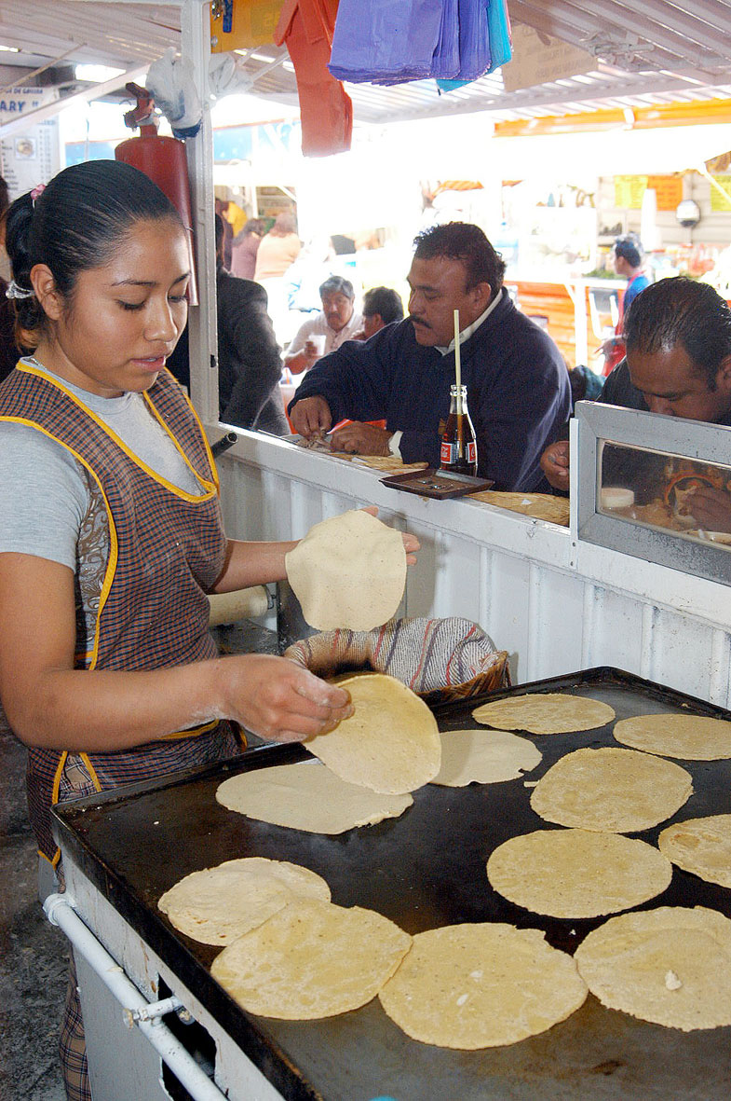
The Tortilla Crisis in Mexico
  Much of the corn used in Mexico is imported from the United States and used to make tortillas.
  Tortillas have long been an inexpensive, but nutritious staple food for low-income families in Mexico.
  Tortillas are made from white corn, which is not a type of corn used to produce ethanol.
  The problem is that in 2007 many farmers switched from white corn to yellow corn (the type used to produce ethanol) because of the high market prices.
  This, in turn, lead to higher prices of white corn, causing tortilla prices to double.
  This sharp increase in price is making tortillas inaccessible to many families.

Slide 8
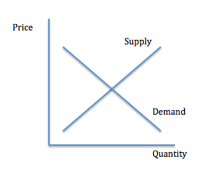
Increase in cost of corn can lead to an increase cost of corn products
  Corn is used in the feed of cattle, poultry and pork. Increased cost of feeding livestock will lead to an increase in meat costs for meat consumers.
    Every 56-pound bushel of corn used in the dry mill ethanol process yields 18 pounds of distiller grains, a good source of energy and protein for livestock and poultry.
    A bushel of corn in the wet mill ethanol process creates 13.5 pounds of corn gluten feed and 2.6 pounds of high-protein corn gluten meal, as well as corn oil used in food processing.
  Farmers switch over to corn due to increase in price. Supply of other crops, such as soybeans, will decrease and increase the costs. This can drive up consumer prices at the grocery store.

Slide 9
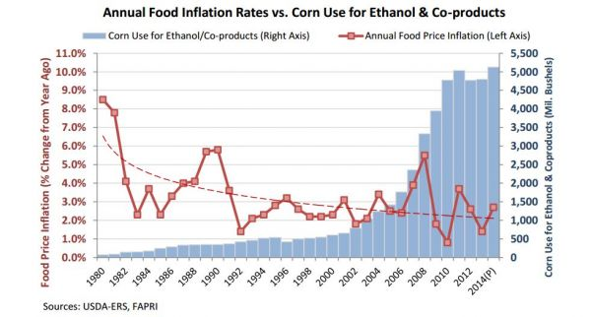
High supply = low cost

